Slide 1
Expectation Setting
Machine Learning– BCS602

Slide 2
AI & ML Introduction
Artificial intelligence generally refers to processes and algorithms that are able to simulate human intelligence.
Ex: Intelligent humanoid robot, personal assistant programs.
Machine learning is an application of AI. It’s the process of using mathematical models of data to help a computer learn without direct instruction
Ex: Google search algorithms, Facebook auto friend tagging suggestions

Slide 3
Importance of the subject
Automation & Efficiency – ML automates repetitive tasks, reducing human effort and increasing efficiency in various industries.
Data-Driven Decision Making – Helps in analyzing large datasets, identifying patterns, and making accurate predictions.
Applications in Various Fields – Used in healthcare (disease detection), agriculture (crop disease identification), finance (fraud detection), and more.
Enhances Accuracy & Precision – ML models improve over time, leading to better performance in tasks like medical diagnosis and image recognition.

Slide 4
Application of the subject in real world

Slide 5

Google Maps’ Traffic
Prediction
Google Maps is probably the app we use whenever we go out and require assistance in directions and traffic. Everyone using maps is providing their location, average speed, the route in which they are traveling which in turn helps Google collect massive Data about the traffic, which makes them predict the upcoming traffic and adjust your route according to it.

Slide 6
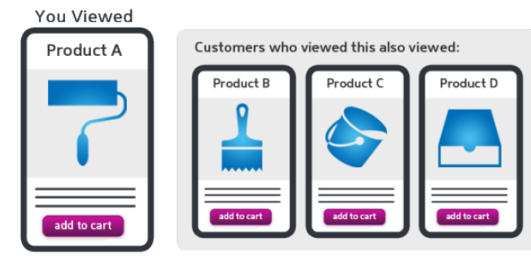
Products
Recommendations
Suppose you check an item on Amazon, but you do not buy it then and there. But the next day, you’re watching videos on YouTube and suddenly you see an ad for the same item. You switch to Facebook, there also you see the same ad. So how does this happen?
Google tracks your search history, and recommends ads based on your search history.

Slide 7

Virtual Personal
Assistants
As the name suggests, Virtual Personal Assistants assist in finding useful information, when asked via text or voice. Few of the major applications of Machine Learning here are:
Speech Recognition, Speech to Text Conversion, Text to Speech Conversion
Personal assistant searches for information or recalls your related queries to collect info. Recently personal assistants are being used in Chatbots which are being implemented in various food ordering apps, online training websites and also in Commuting apps.

Slide 8
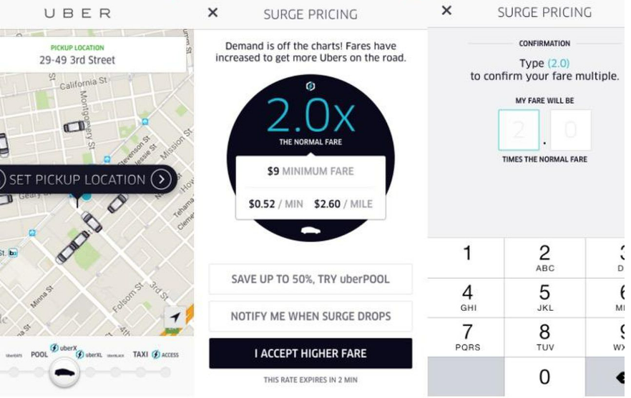
Real-Time Dynamic Pricing
When booking a flight ticket to travel on New Year’s Eve, or while hiring an Uber in the peak office hours, you see a big gap between the normal pricing and pricing for that particular occasion. Generally, companies charge surge prices whenever the demand is high.

Slide 9
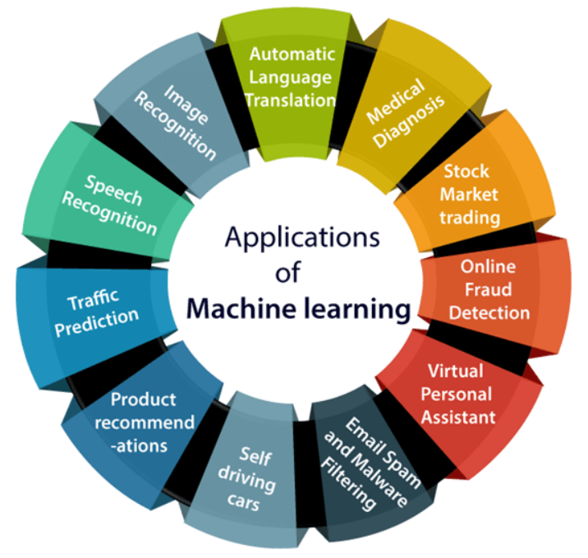
Applications of Machine Learning

Slide 10
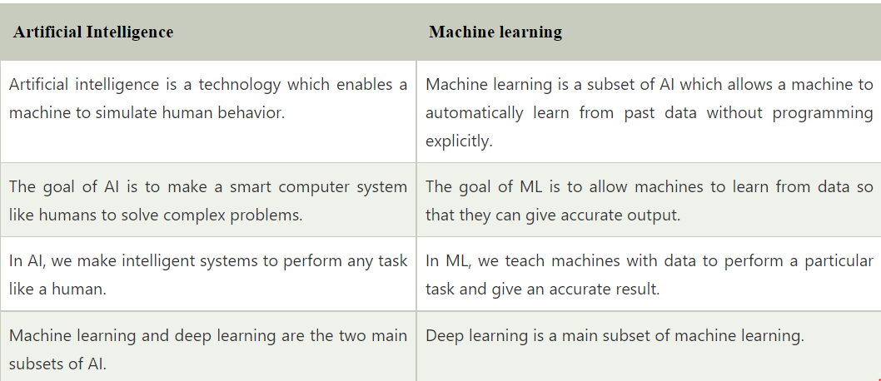
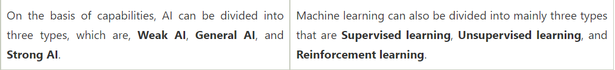
Difference

Slide 11
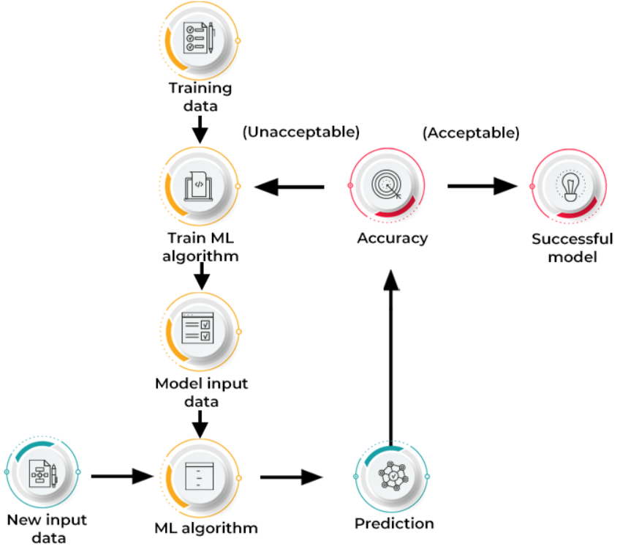
How Machine Learning Works

Slide 12
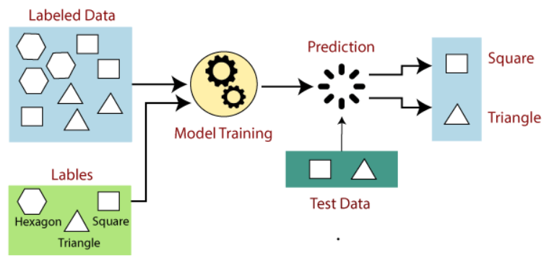
Examples: Supervised Learning
Is it a cat or a dog?

Slide 13
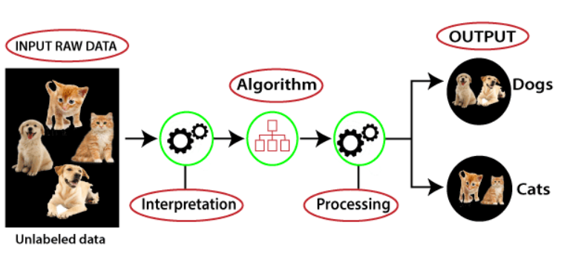
Example : Unsupervised Learning

Slide 14
Reinforcement Learning
Reinforcement Learning is a feedback-based Machine learning technique in which an agent learns to behave in an environment by performing the actions and seeing the results of actions.
"Reinforcement learning is a type of machine learning method where an intelligent agent (computer program) interacts with the environment and learns to act within that." How a Robotic dog learns the movement of his arms is an example of Reinforcement learning.

Slide 15
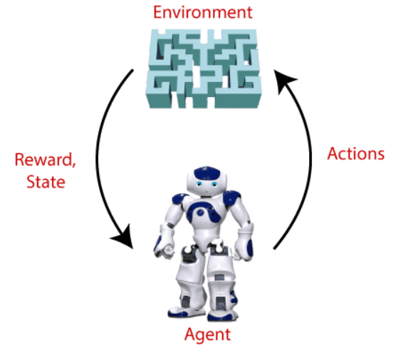
Reinforcement Learning

Slide 16
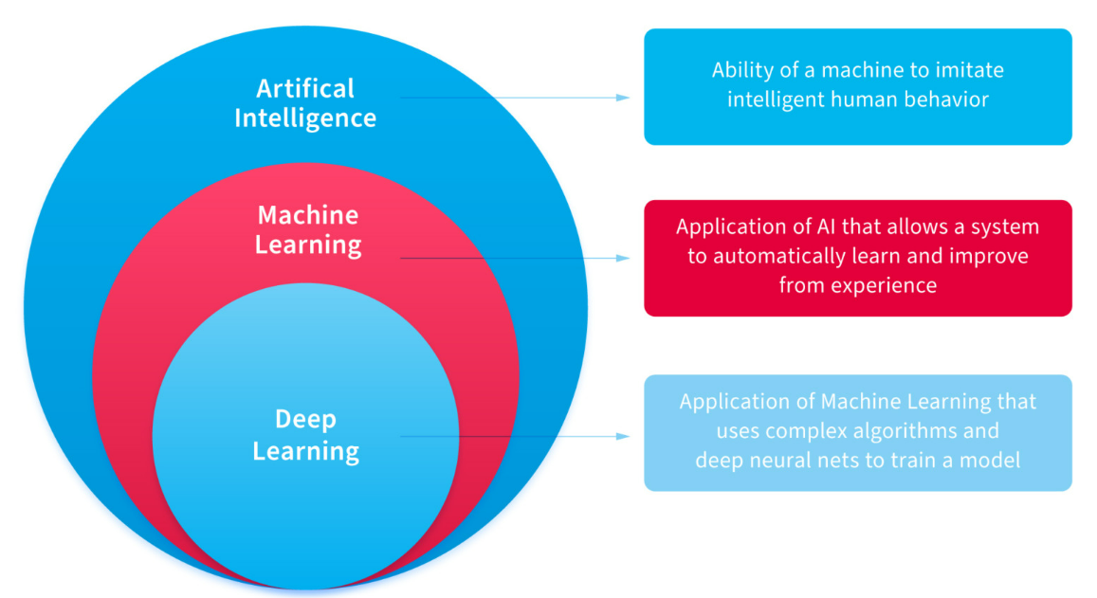

Slide 17

Online Video Streaming (Netflix)
The Netflix algorithm constantly gathers massive amounts of data about users’ activities like:
When you pause, rewind, or fast forward
What day you watch content (TV Shows on Weekdays and Movies on Weekends)
The Date and Time you watch
When you pause and leave content (and if you ever come back)
The ratings Given (about 4 million per day), Searches (about 3 million per day)
Browsing and Scrolling Behavior

Slide 18
Course Objectives
To introduce the fundamental concepts and techniques of machine learning.
To understanding of various types of machine learning and the challenges faced in realworld applications.
To familiarize the machine learning algorithms such as regression, decision trees, Bayesian models, clustering, and neural networks.
To explore advanced concept like reinforcement learning and provide practical insight into its applications.
To enable students to model and evaluate machine learning solutions for different types of problems.

Slide 19
Pre-requisites
Probability and statistics
Linear Algebra
Calculus

Slide 20
Course Outcomes
By the end of this course, students will be able to :
CO1. Describe the machine learning techniques, their types and data analysis framework.
CO2. Apply mathematical concepts for feature engineering and perform dimensionality reduction to enhance model performance.
CO3. Develop similarity-based learning models and regression models for solving classification and prediction tasks.
CO4. Build probabilistic learning models and design neural network models using perceptrons and multilayer architectures
CO5. Utilize clustering algorithms to identify patterns in data and implement reinforcement learning techniques

Slide 21
Program Outcomes as defined by NBA (PO)
1. Engineering knowledge: Apply the knowledge of mathematics, science, engineering fundamentals, and an engineering specialization to the solution of complex engineering problems.
2. Problem analysis: Identify, formulate, review research literature, and analyze complex engineering problems reaching substantiated conclusions using first principles of mathematics, natural sciences, and engineering sciences.
3. Design/development of solutions: Design solutions for complex engineering problems and design system components or processes that meet the specified needs with appropriate consideration for the public health and safety, and the cultural, societal, and environmental considerations.
4. Conduct investigations of complex problems: Use research-based knowledge and research methods including design of experiments, analysis and interpretation of data, and synthesis of the information to provide valid conclusions.

Slide 22
Program Outcomes as defined by NBA (PO)
5. Modern tool usage: Create, select, and apply appropriate techniques, resources, and modern engineering and IT tools including prediction and modeling to complex engineering activities with an understanding of the limitations.
6. The engineer and society: Apply reasoning informed by the contextual knowledge to assess societal, health, safety, legal and cultural issues and the consequent responsibilities relevant to the professional engineering practice.
7. Environment and sustainability: Understand the impact of the professional engineering solutions in societal and environmental contexts, and demonstrate the knowledge of, and need for sustainable development.
8. Ethics: Apply ethical principles and commit to professional ethics and responsibilities and norms of the engineering practice.

Slide 23
Program Outcomes as defined by NBA (PO)
9. Individual and team work: Function effectively as an individual, and as a member or leader in diverse teams, and in multidisciplinary settings.
10. Communication: Communicate effectively on complex engineering activities with the engineering community and with society at large, such as, being able to comprehend and write effective reports and design documentation, make effective presentations, and give and receive clear instructions.
11. Project management and finance: Demonstrate knowledge and understanding of the engineering and management principles and apply these to one’s own work, as a member and leader in a team, to manage projects and in multidisciplinary environments.
12. Life-long learning: Recognize the need for, and have the preparation and ability to engage in independent and life-long learning in the broadest context of technological change.

Slide 24
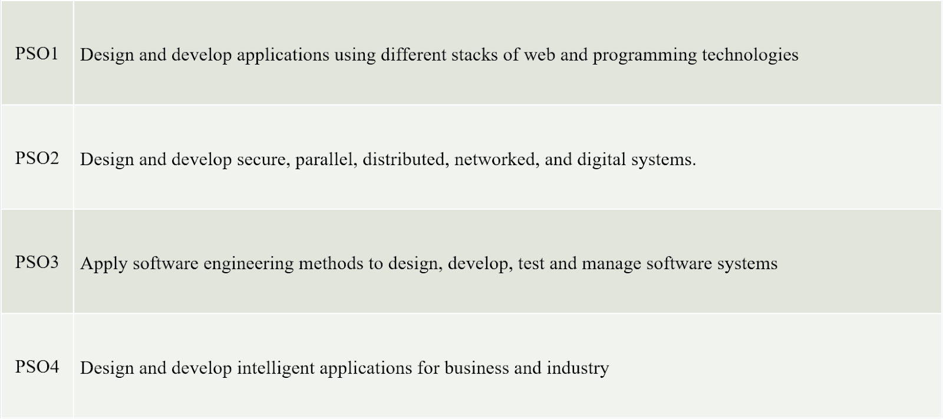
Program Specific Objectives(PSO)

Slide 25
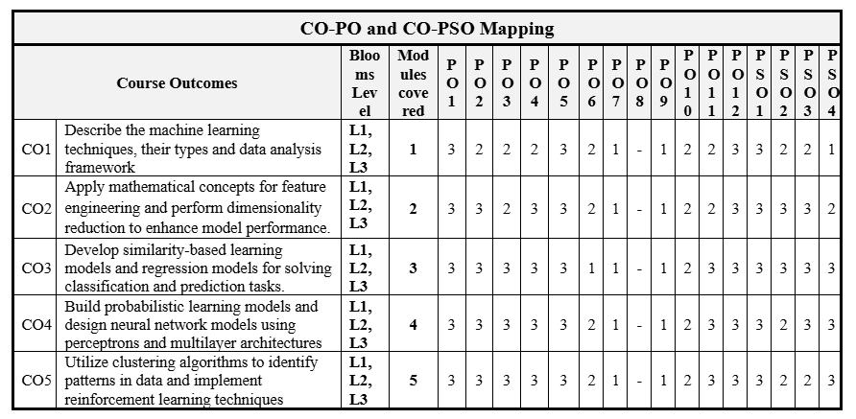
CO-PO mapping

Slide 26
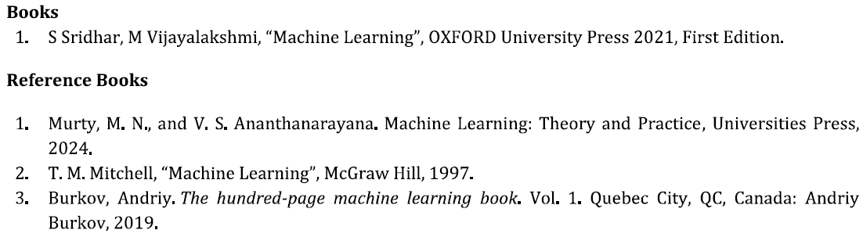
Text books and Reference books

Slide 27
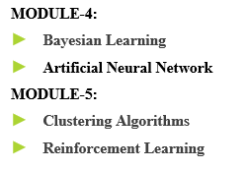
Overview of Lesson Plan
MODULE–1:
Introduction
Understanding Data-1
MODULE-2:
Understanding Data-2
Basics of Learning theory
MODULE-3:
Similarity-Based Learning
Regression Analysis
Decision Tree Learning

Slide 28
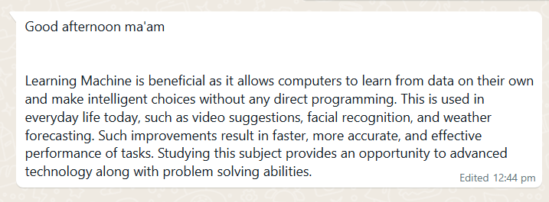
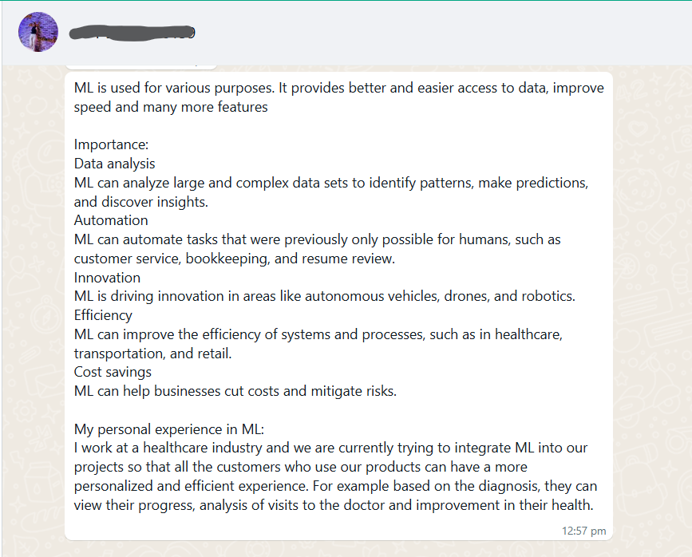
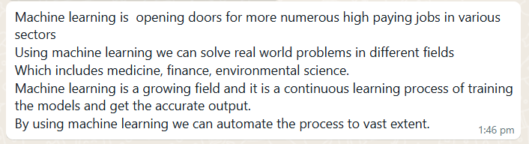
Experience of Past batch students

Slide 29
Expected classroom behaviour
Classroom behaviour: Should come to the class on time and be active.
Policy on copying assignments (no plagiarism),
sticking to deadlines for submissions,
attendance policy (reiterate serious about attendance), strict action against abusers of any type etc.

Slide 30
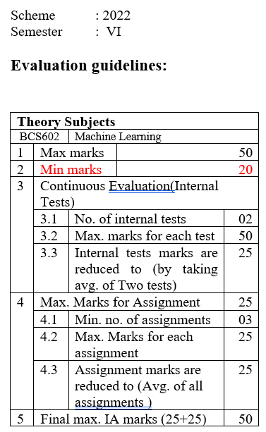
Evaluation Guidelines

Slide 31
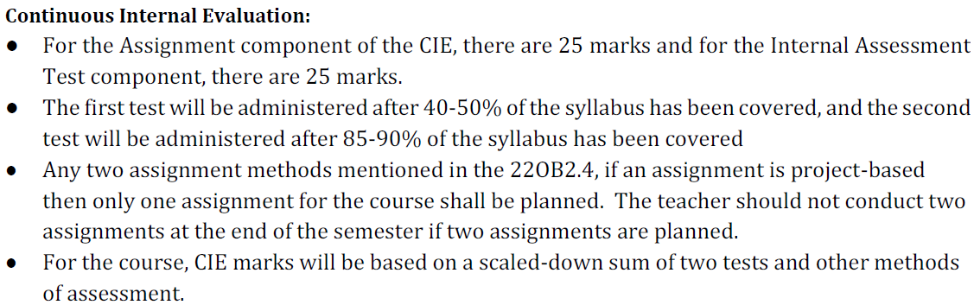
Assessment Schedule
IAT -1 - 40-50% of the syllabus
IAT - 2 - 85-90% of the Syllabus

Slide 32
Best Practices
Case Studies
Short videos from YouTube
To check the student attentiveness during classes, questions are asked to randomly chosen students in between the class.
Explaining theory with live examples

Slide 33
Some Useful Links
https://onlinecourses.nptel.ac.in/noc22_cs73/preview
https://onlinecourses.nptel.ac.in/noc22_cs97/preview
https://onlinecourses.nptel.ac.in/noc22_ma40/preview

Slide 34
Weblinks and Video Lectures (e-Resources)
1. https://www.kdnuggets.com/2019/11/10-free-must-read-books-ai.html
2. https://www.udacity.com/course/knowledge-based-ai-cognitive-systems--ud409
3. https://nptel.ac.in/courses/106/105/106105077/
4. https://www.javatpoint.com/history-of-artificial-intelligence
5. https://www.tutorialandexample.com/problem-solving-in-artificial-intelligence
6. https://techvidvan.com/tutorials/ai-heuristic-search/
7. https://www.analyticsvidhya.com/machine-learning/
8. https://www.javatpoint.com/decision-tree-induction
9. https://www.hackerearth.com/practice/machine-learning/machine-learning-algorithms/ml-decision-tree/tutorial/
10. https://www.javatpoint.com/unsupervised-artificial-neural-networks

Slide 35
Opportunities for Masters in Machine Learning
1. Carnegie Mellon University
2. University of California — Berkeley
3. Stanford University
4. Massachusetts Institute of Technology
5. Cornell University
6. University of California — San Diego (UCSD)
7. Georgia Institute of Technology
8. University of Washington
9. University of California — Los Angeles (UCLA)
10. Columbia University

Slide 36
Different job roles in Machine Learning
Machine Learning Engineer
Robotics Engineer
Natural Language Processing (NLP) Scientist
Software Developer/Engineer (AI/ML)
Artificial Intelligence (AI) Engineer
Data Scientist
Business Intelligence Developer

Slide 37
Job Opportunities
Apple
Wipro
Amazon
Facebook
IBM
Tata Consultancy Services
Google
Cognizant Technology Solutions

Slide 38
Thank You

